Slide 1
Distributed Lossy Image Compression with Recurrent Networks
Enmao Diao
PhD. candidate
Duke University
Durham, NC
05/21/2019

Slide 2
Outline
Introduction
Related Works
Image Compression with Deep Learning
Distributed Source Coding
Methods
Architecture
Module
Deep Distributed Source Coding Framework
Experiments
Experiment Setup
Compression
Arbitrary Correlated Sources
Low Complexity Encoding
Robust Distributed Encoding
Conclusions

Slide 3
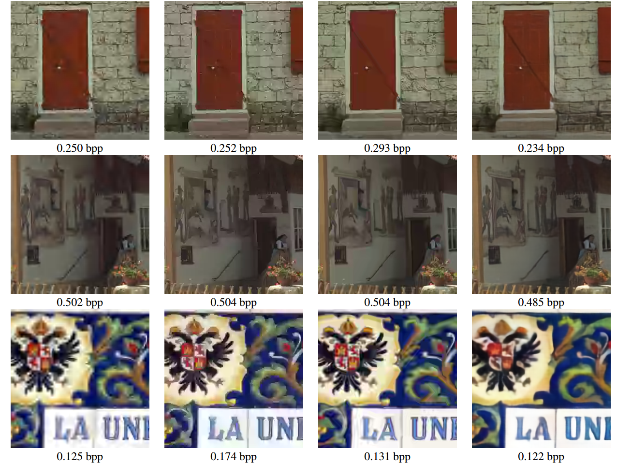
Introduction
Neural Network based compression methods can achieve comparable results as classical image compression techniques like JPEG and BPG [1,2]
JPEG 2000 WebP BPG reviewed papers

Slide 4
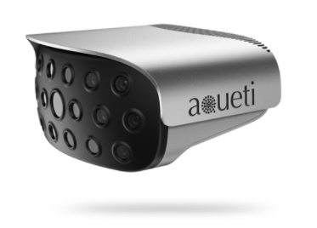
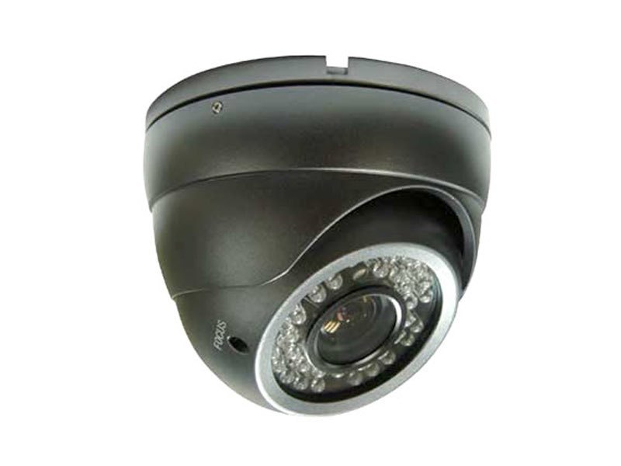
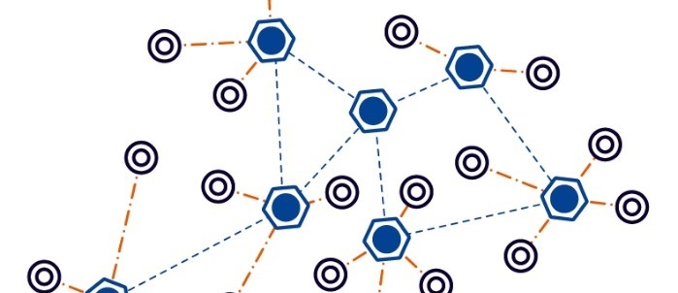
Introduction
Distributed nature of machines, processes, and humans will necessitate decentralized processing in order to provide perception of the environment
high-resolution surveillance cameras
sensor networks
Can distributed encoders perform as well as a single encoder trained with all data sources together?

Slide 5
Introduction
A positive answer from theoretical perspective was given in the context of Distributed Source Coding (DSC)
The Slepian-Wolf Theorem shows that lossless coding of two or more correlated data sources with separate encoders and a joint decoder can compress data as efficiently as the optimal coding using a joint encoder and decoder [3,4]
Lossy distributed compression is shown by Wyner-Ziv Theorem but only limited to correlated Gaussian data sources [5]
Practical DSC requires customized code design with specific assumptions of data sources and estimation of correlations [6]
Little attention has been paid to a systematic approach for general and practical distributed code design, especially in the presence of an arbitrary number of nontrivial data sources with arbitrary correlation.
Can data-driven DSC framework handles nontrivial distribution of data sources with arbitrary correlations?

Slide 6
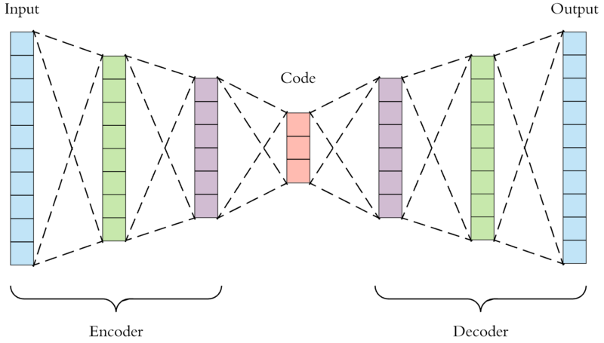
Related Works
Image Compression with Deep Learning
Most of deep learning based image compression methods are based on autoencoder networks and quantization of bottleneck representations
Unavoidable to train multiple models with different regularization parameters separately for different compression rates
Figure 1. Illustration of Deep Image Compression with Autoencoder.

Slide 7
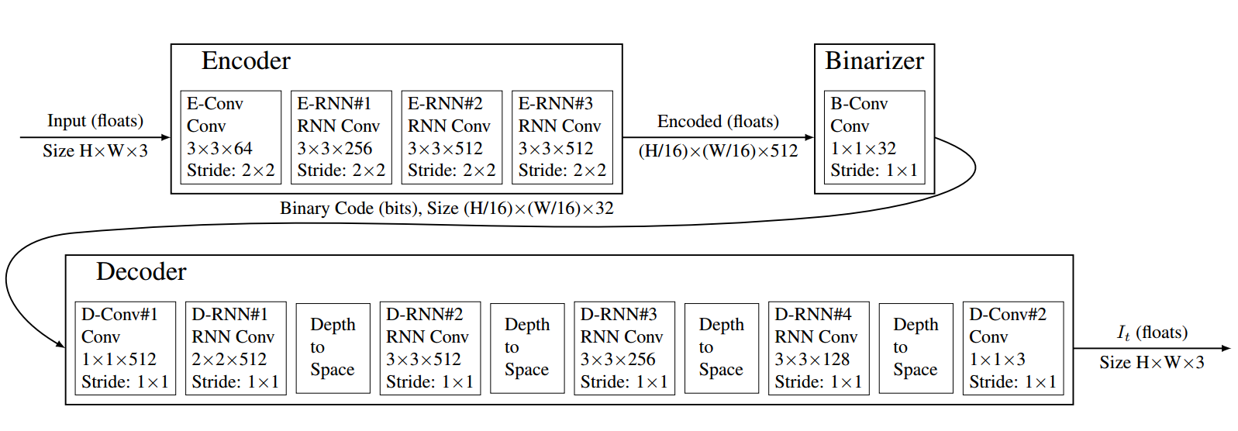
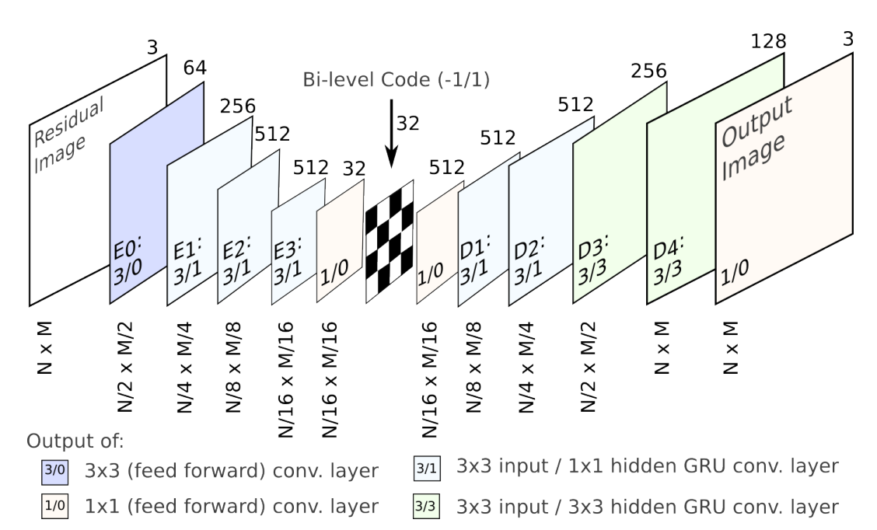
Related Works
Image Compression with Deep Learning
The recurrent neural network (RNN) based architecture is known to be the pioneering architecture that outperforms classical codecs [7,8].
The compression rate is varying according to the number of iterations of a single recurrent model.
Figure 2. Illustration of Deep Image Compression with Recurrent Autoencoder [7,8].

Slide 8
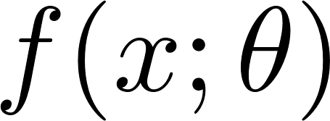

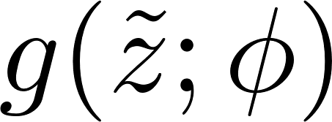

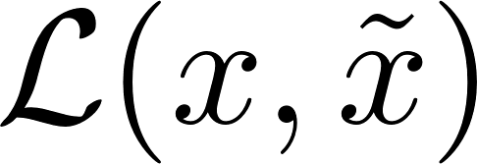


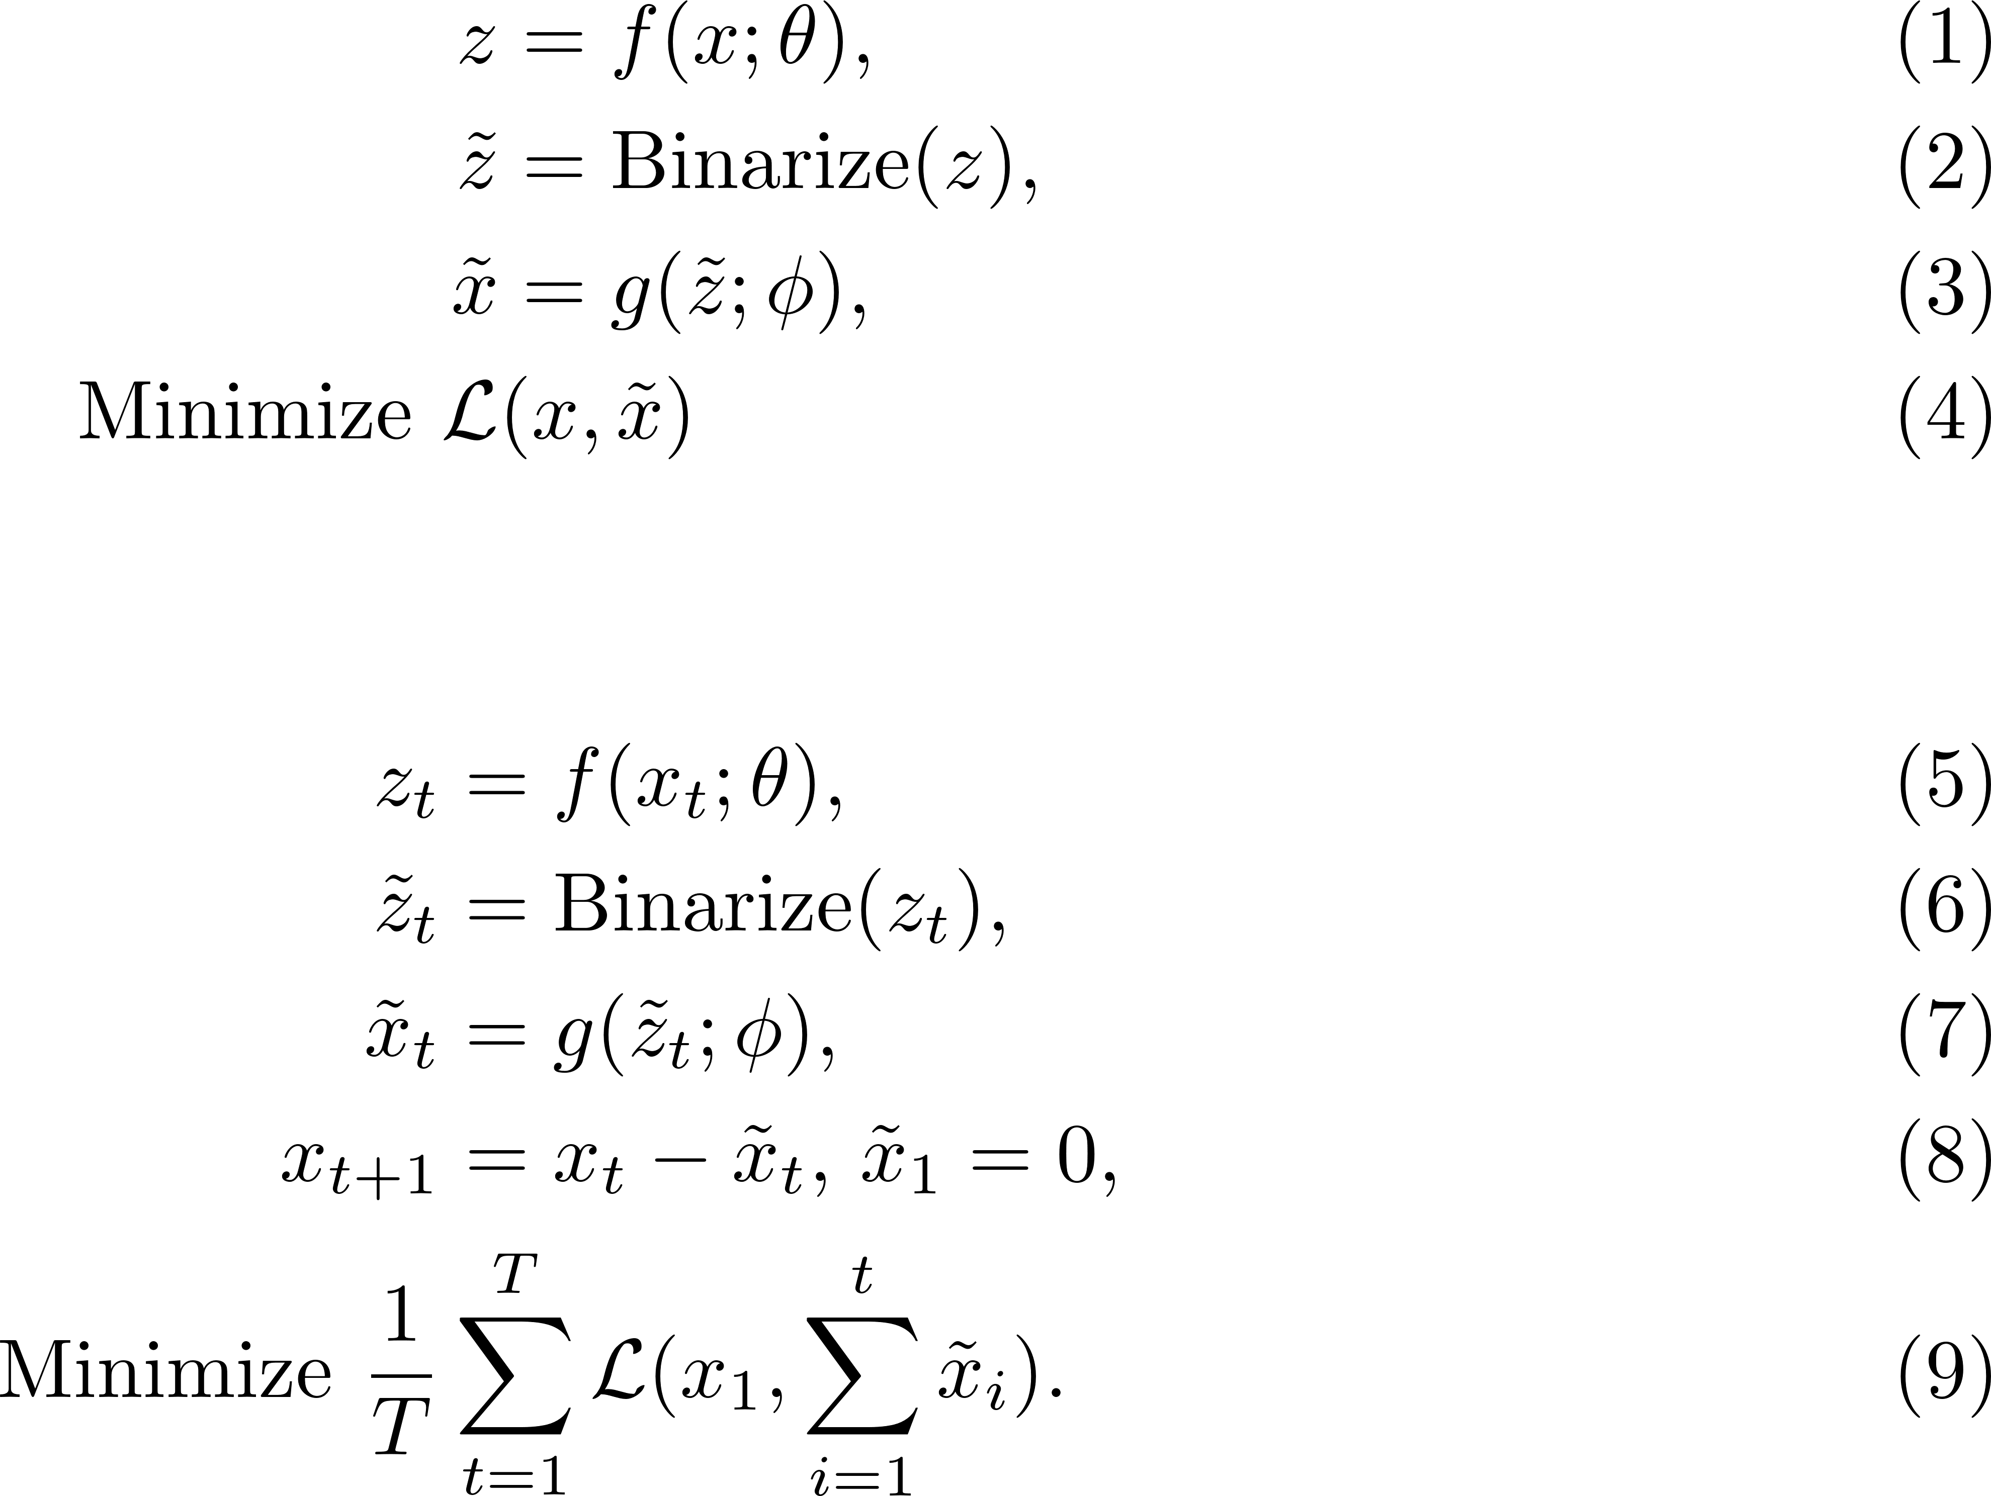
Related Works
Image Compression with Deep Learning
Given neural network-based encoder , quantized codes and encoder . We can binarize bottleneck representations and control the compression quality by varying the channel size of . The loss function is minimized with respect to the model parameters and .
Non-recurrent autoencoder
Recurrent autoencoder

Slide 9
Related Works
Distributed Source Coding
A decoder would like to reconstruct observations at various sensors/cameras with minimal communications
Data sources are i.i.d. (not realistic)
Joint statistics are known in advance (not fully realistic)
Distributed source coding with lossy sources is not a fully solved problem even for i.i.d. sources

Slide 10
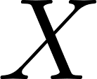
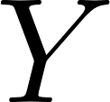
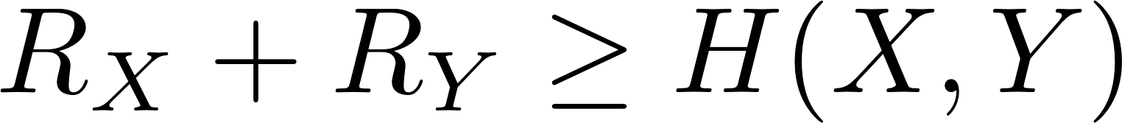
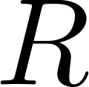
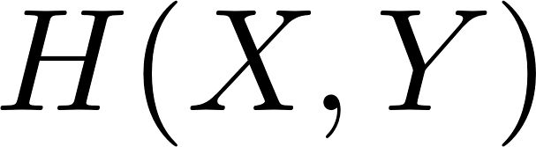
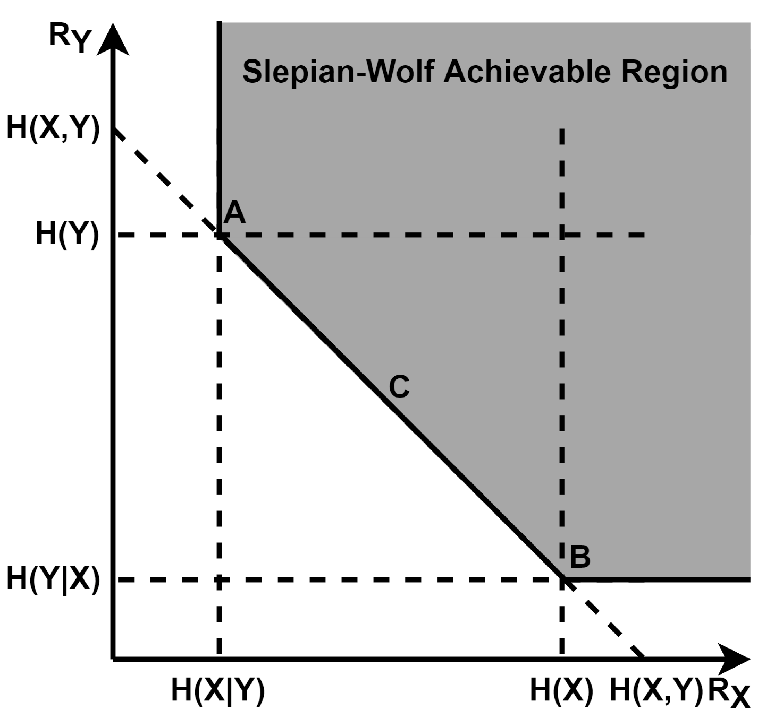
Related Works
Distributed Source Coding for lossless i.i.d. sources
Separate encoding and Joint decoding of two correlated data sources and
The achievable region proved by the Slepian-Wolf Theorem is given by
and
Optimal bit rate is achieved at joint entropy
Figure 3. The Slepian-Wolf achievable region for two sources and .

Slide 11


Related Works
Distributed Source Coding for lossless i.i.d. sources
Corner points and can be achieved with “syndrome” bits used in Distributed Source Coding Using Syndromes (DISCUS) [9], where
, and
Corner points require careful data synchronization and vulnerable against malfunction of distributed syndrome encoders
Figure 3. The Slepian-Wolf achievable region for two sources and .

Slide 12
Methods
Architecture
Scalable symmetric Encoder-Decoder architecture with convolutional Long-short term memory (ConvLSTM) Networks
Use Pixel (Un)Shuffle to rescale feature maps in order to compress and reconstruct images
Figure 4. Illustration of pixel-shuffled symmetric Encoder-Decoder architecture.

Slide 13
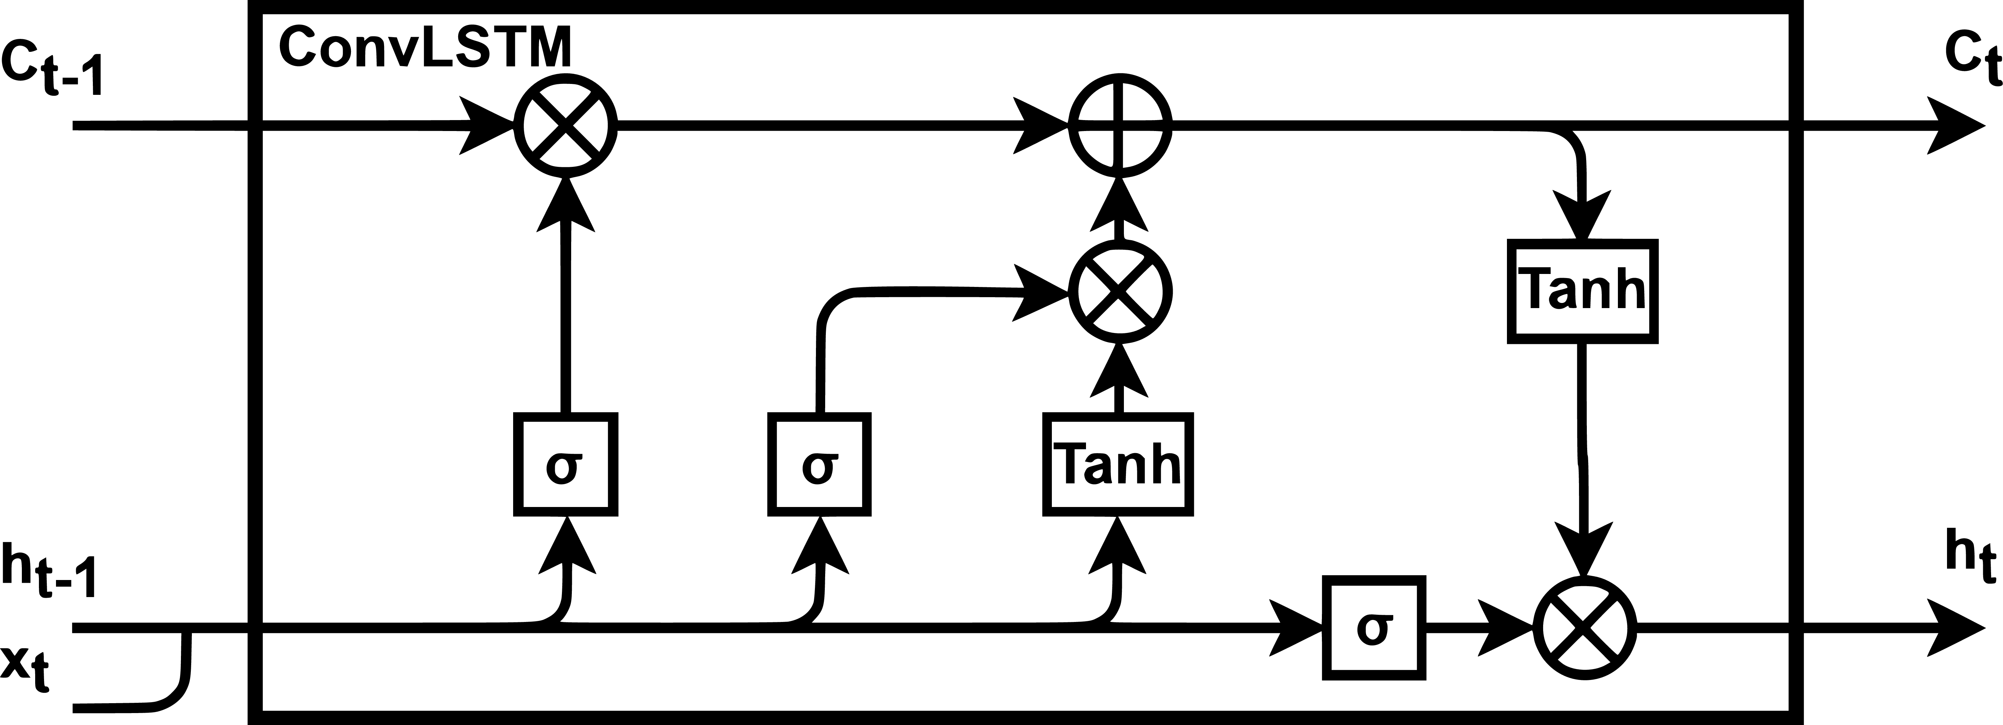
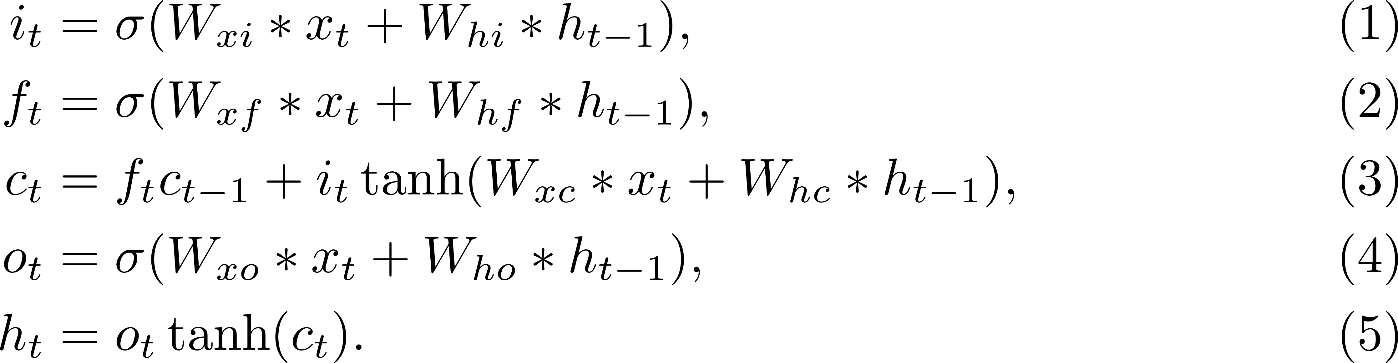
Methods
Module
Convolutional LSTM [9]
Replace Linear module in Long short term memory (LSTM) with Convolution module
Figure 5. Illustration of Convolutional LSTM.

Slide 14
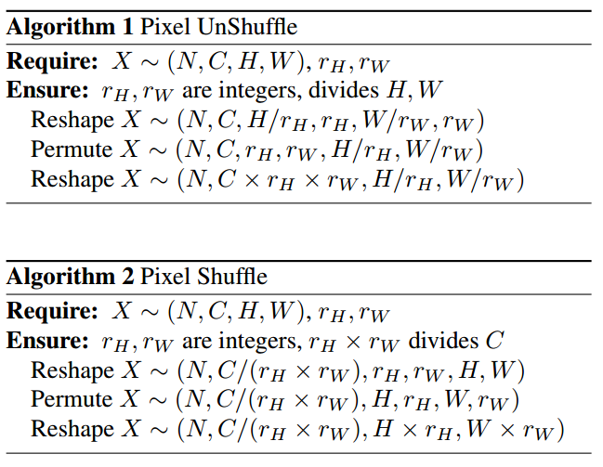
Methods
Module
Pixel (Un)Shuffle
Generalize Pixel Shuffle module proposed by [10] for tackling image super-resolution problem.
Resize feature maps for both Encoder and Decoder.
Compared to bilinear interpolation and (transposed) convolutional layers, Pixel (Un)Shuffle module is much more computationally efficient, because it is non-parametric and only requires tensor reshaping and dimension permutation.

Slide 15
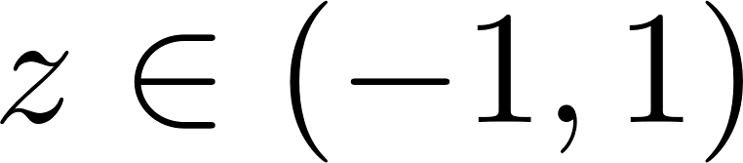
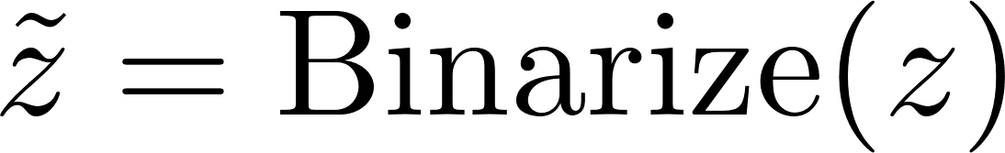
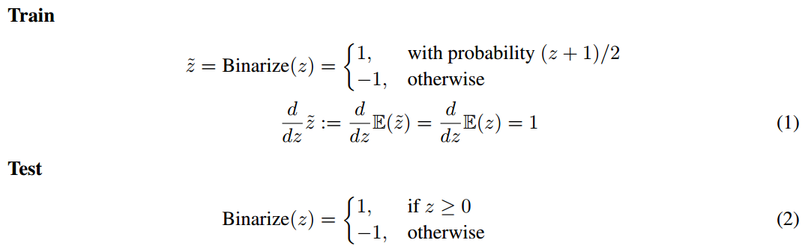
Methods
Module
Binarizer
Images are down-sampled from (3,32,32) to (8,4,4). The input of binarizer is in the range [-1,1] due to tanh(.) activation. Each element in the tensor is binarized with following equations. To approximate the noise from the quantization, we use a stochastic form of binarization during training [7,11].
For bottleneck representations , the details of Binarizer
are described as follows

Slide 16
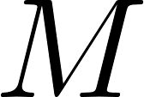
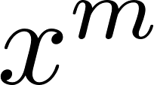
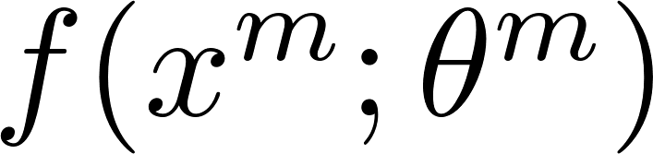
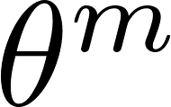
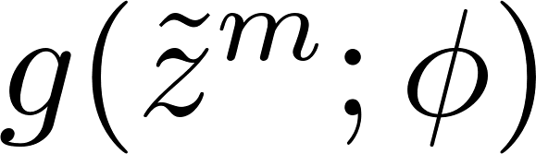
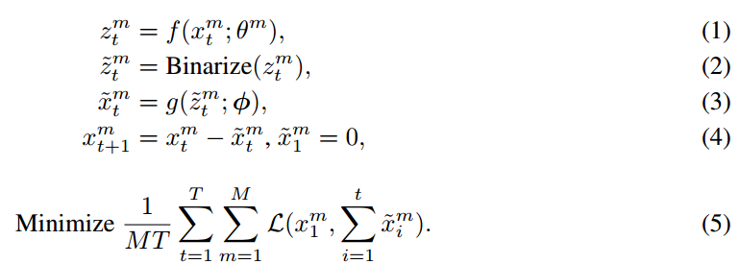
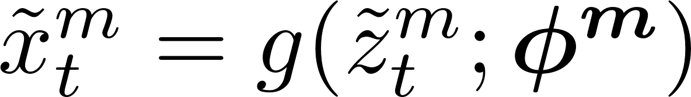
Methods
Deep Distributed Source Coding Framework
distributed encoders encode corresponding data sources that can be arbitrarily correlated.
Encoder has their own model parameters . One decoder reconstructs images with the same model parameters .
If we encode and decode each data source separately, the performance becomes significantly worse.

Slide 17
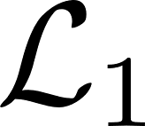
Experiments
Experiment Setup
Use MNIST dataset, 60000 handwritten 0-9 digits images for training, 10000 digits for testing, and resized to 32x32.
Training data are split by random subsets or by class labels and each encoder only has access to one specific subset. We test each individual pair of encoder and decoder with all test data and show its robustness by plotting its confidence band.
We train with Loss and Stochastic Gradient Descent (SGD) of batch size 100. We run 200 Epochs at learning rate 0.001 with Adam Optimizer. We evaluate all models with the metric Peak Signal to Noise Ratio (PSNR) against the Bit Per Pixel (BPP).
The difference between the input image and reconstructed image is used at next iteration. We iterate 16 times and achieve 2 Bit Per Pixel (BPP) as total.
Further compression can be achieved with entropy coding but this was not attempted in the simulations. Other hyperparameters setup are shown in the written report.

Slide 18
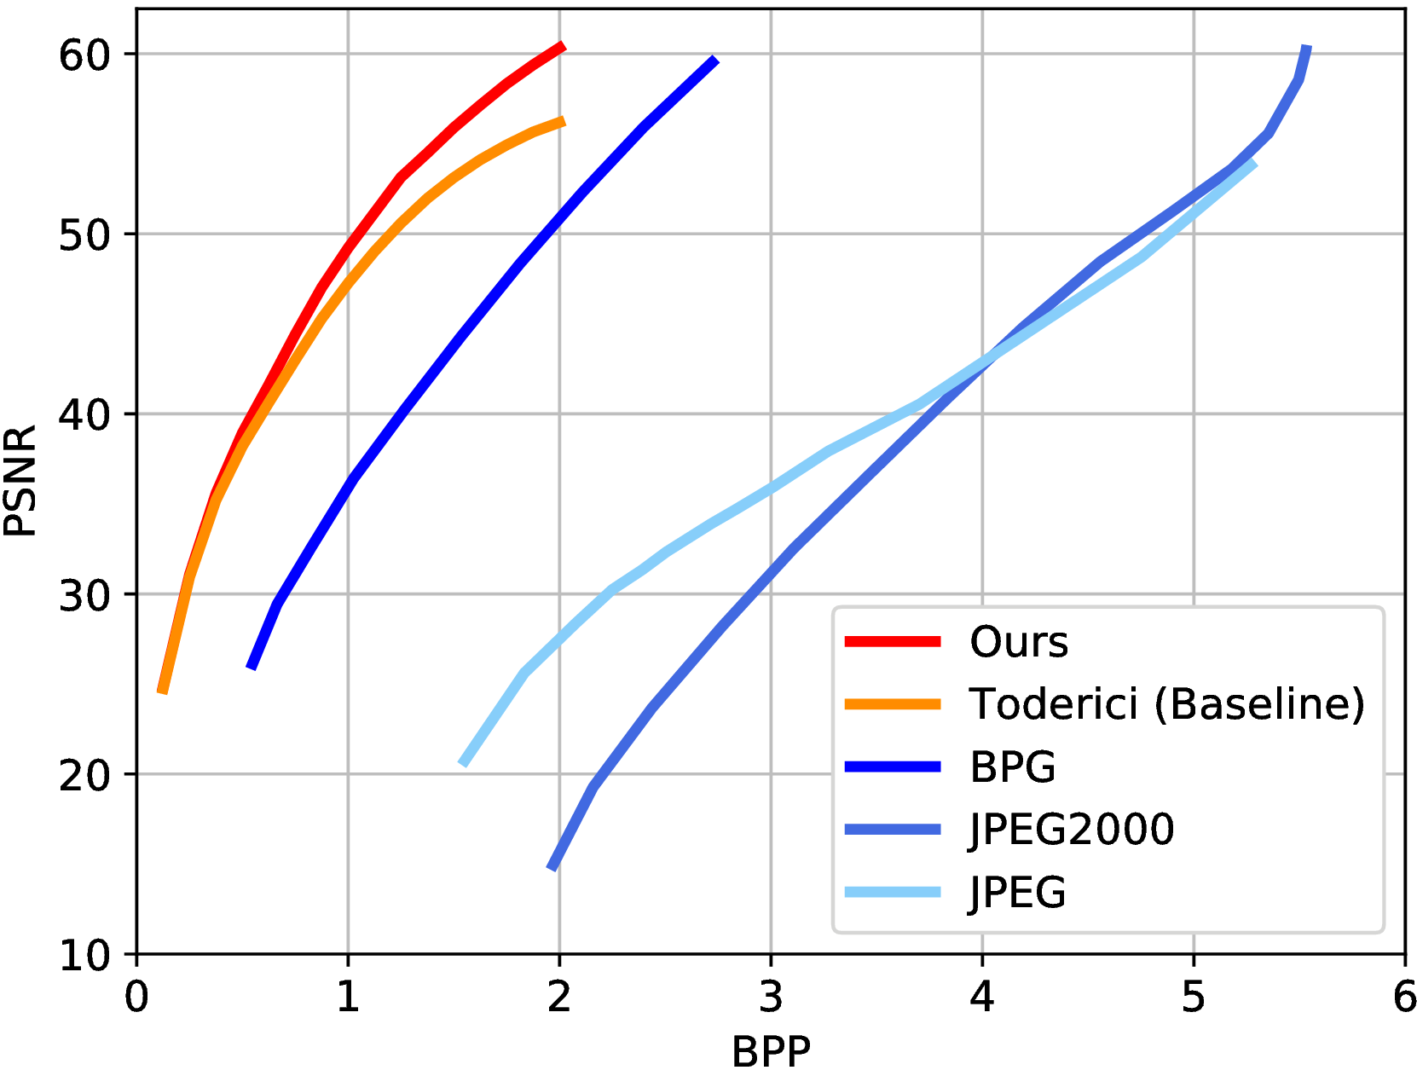
Experiments
Compression
Symmetric pixel-shuffled Encoder-Decoder architecture outperforms classical codecs and baseline neural network-based codecs.
Figure 6. Our symmetric pixel-shuffled Encoder-Decoder outperforms classical codecs and baseline neural network-based codecs.

Slide 19
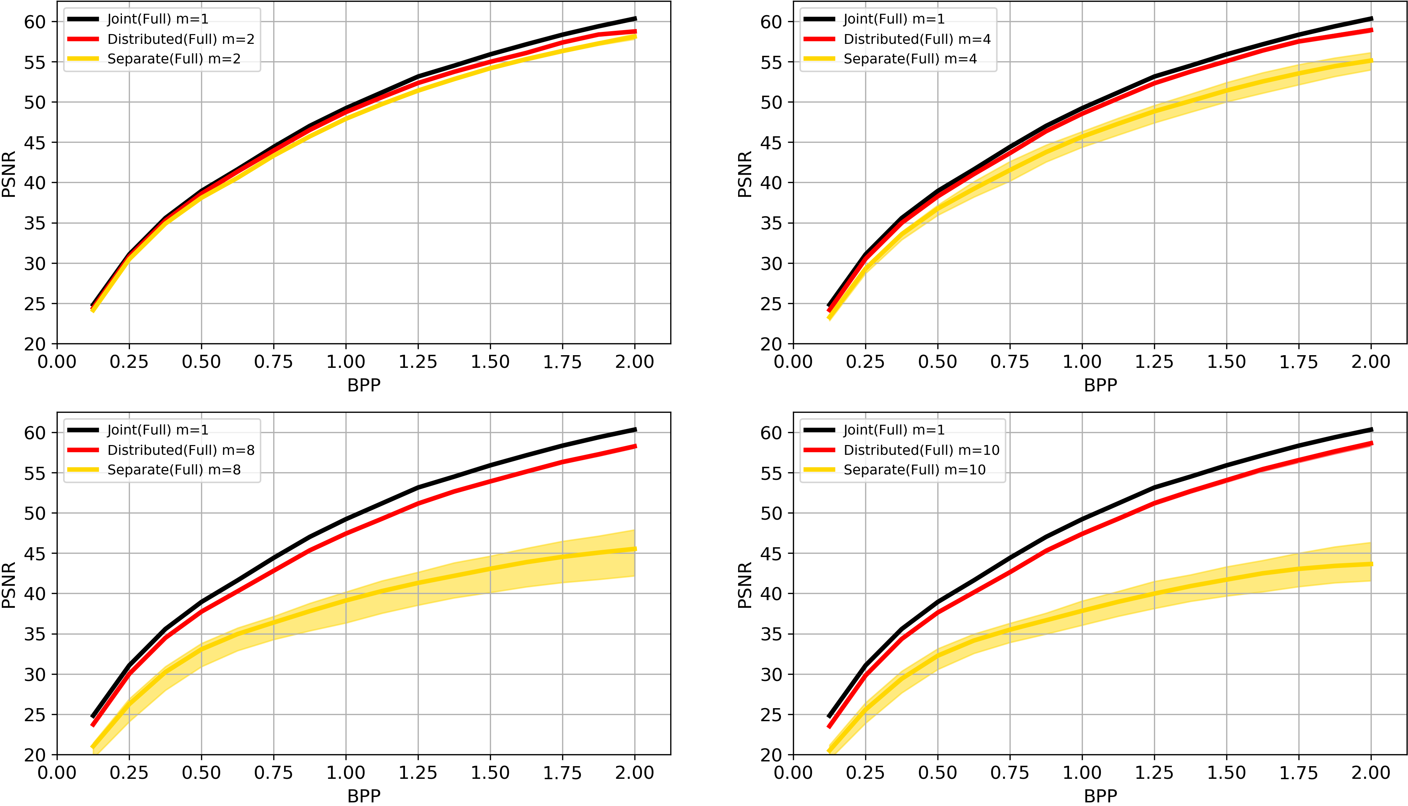
Experiments
Arbitrary Correlated Sources
The curve of distributed encoders shows that the performance of training distributed encoders and joint decoder can be very close to the theoretical limit.
Deep DSC framework is able to adaptively learn arbitrary correlations among arbitrary number of data sources.
Figure 7. Rate-distortion curves for data sources distributed by random subsets with T = 16 for all sources.

Slide 20
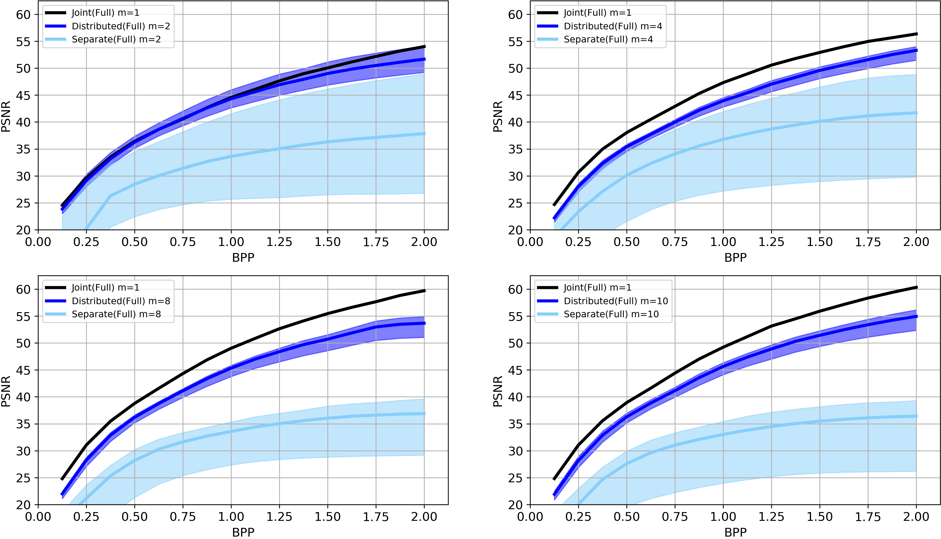
Experiments
Arbitrary Correlated Sources
The curve of distributed encoders shows that the performance of training distributed encoders and joint decoder can be very close to the theoretical limit.
Deep DSC framework is able to adaptively learn arbitrary correlations among arbitrary number of data sources.
Figure 8. Rate-distortion curves for data sources distributed by class labels with T = 16 for all sources.

Slide 21
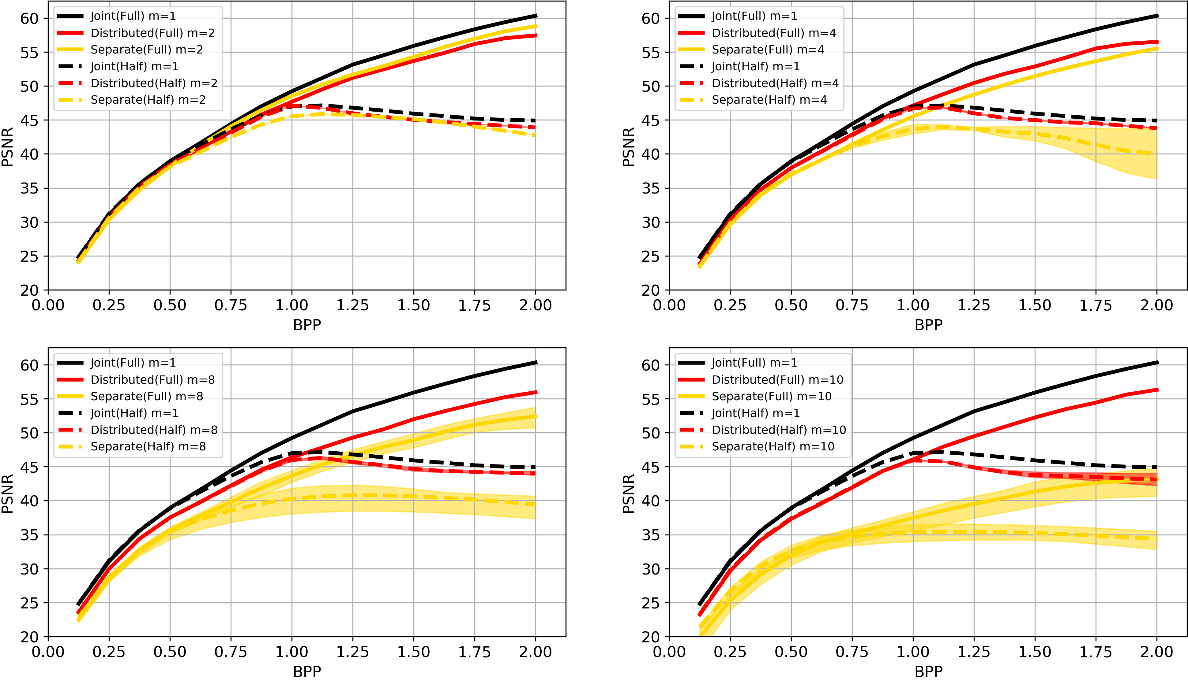
Experiments
Low Complexity Encoding
The first half of encoders are trained with 16 iterations, labeled as Full, and the second half of encoders are only trained with 8 iterations, labeled as Half.
Full and Half complexity encoders can still approach their theoretical limits.
Figure 9. Rate-distortion curves for data sources distributed by random subsets with T = 16 for the first half of sources and T = 8 for the second half of sources.

Slide 22
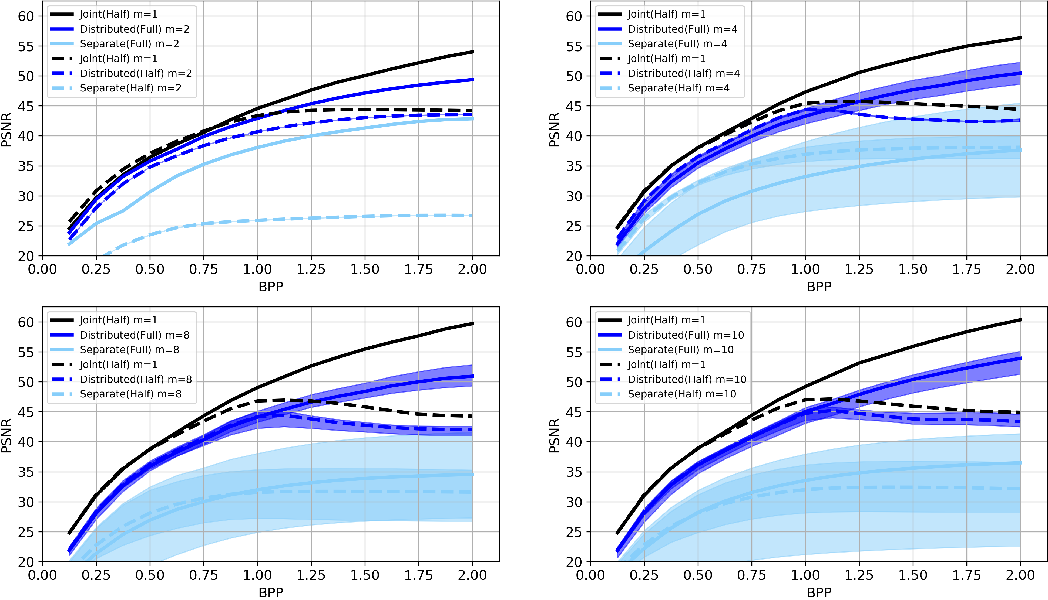
Experiments
Low Complexity Encoding
The first half of encoders are trained with 16 iterations, labeled as Full, and the second half of encoders are only trained with 8 iterations, labeled as Half.
Full and Half complexity encoders can still approach their theoretical limits.
Figure 10. Rate-distortion curves for data sources distributed by class labels with T = 16 for the first half of sources and T = 8 for the second half of sources.

Slide 23
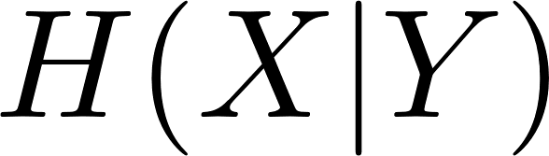
Experiments
Robust Distributed Encoding
In classical DSC code design, if syndrome bits are used and the data source is accidentally blocked, we will not be able to decode data source .
In our data-drive DSC framework, even only one of distributed encoders is functional, it can still benefits from its correlations with other sources because their correlations are already trained with the model parameters.
All our experiments show that distributed encoders not only dominates separately trained codecs but also have narrower confidence band.
As the number of iterations increases, the confidence band also becomes wider. This is because the residual differences at later iterations become less correlated.
The confidence band of data sources distributed by class labels is also wider than that of data sources distributed by random subsets, because encoders specialize on data with the same label and therefore perform worse on other labels.

Slide 24
Conclusions
We introduce a data-driven Distributed Source Coding framework based on Deep Recurrent models. Compared to classical code design, our method has the following advantages.
The compression quality of our recurrent model is scalable.
Arbitrary number of data sources with arbitrary correlations can be encoded separately and decoded jointly while still perform as well as gathering all data sources together.
low complexity encoder is also shown to be feasible based on our experimental results.
The robustness of our framework allows each distributed encoder, once trained and deployed, can be used independently of others because the correlations are already learned by the model parameters.

Slide 25
References
[1] Wallace, Gregory K. "The JPEG still picture compression standard." IEEE transactions on consumer electronics 38.1 (1992): xviii-xxxiv.
[2] F. Bellard, “BPG image format,” 2014. [Online]. Available: https://bellard.org/bpg/ 2, 5
[3] Slepian, David, and Jack Wolf. "Noiseless coding of correlated information sources." IEEE Transactions on information Theory 19.4 (1973): 471-480.
[4] Cover, T. "A proof of the data compression theorem of Slepian and Wolf for ergodic sources (Corresp.)." IEEE Transactions on Information Theory 21.2 (1975): 226-228.
[5] Wyner, Aaron, and Jacob Ziv. "The rate-distortion function for source coding with side information at the decoder." IEEE Transactions on information Theory 22.1 (1976): 1-10.
[6] Xiong, Zixiang, Angelos D. Liveris, and Samuel Cheng. "Distributed source coding for sensor networks." IEEE signal processing magazine 21.5 (2004): 80-94.
[7] Toderici, George, et al. "Full resolution image compression with recurrent neural networks." Proceedings of the IEEE Conference on Computer Vision and Pattern Recognition. 2017.
[8] Johnston, Nick, et al. "Improved lossy image compression with priming and spatially adaptive bit rates for recurrent networks." Proceedings of the IEEE Conference on Computer Vision and Pattern Recognition. 2018.
[9] Xingjian, S. H. I., et al. "Convolutional LSTM network: A machine learning approach for precipitation nowcasting." Advances in neural information processing systems. 2015.
[10] Shi, Wenzhe, et al. "Real-time single image and video super-resolution using an efficient sub-pixel convolutional neural network." Proceedings of the IEEE conference on computer vision and pattern recognition. 2016.
[11] Theis, Lucas, et al. "Lossy image compression with compressive autoencoders." arXiv preprint arXiv:1703.00395 (2017).

